Slide 1
Studying state-of-the-art HTAP systems
- Satya Sai Bharath Vemula
- Rwitam Bandyopadhyay
- Shubham Pandey
Milestone 3

Slide 2
Table of Contents
SnappyData (~14 min)
VoltDB (~13 min)
DB2 BLU (~13 min)
Project Summary
Notes:
Quickly going through the agenda for today.
We will go through a brief introduction of what HTAP systems are, the challenges involved, and some common HTAP architectural styles.
We will then cover 3 DB systems today and see how they achieve HTAP.

Slide 3
SnappyData
Disagg1
Presented by Satya Sai Bharath Vemula

Slide 4
SnappyData
Introduction
Recently acquired by TIBCO and re-named as TIBCO Compute DB
A Unified Cluster for OLTP, OLAP and Streaming
This is a HTAP database which was primarily envisioned to solve problems with Lambda Architecture

Slide 5
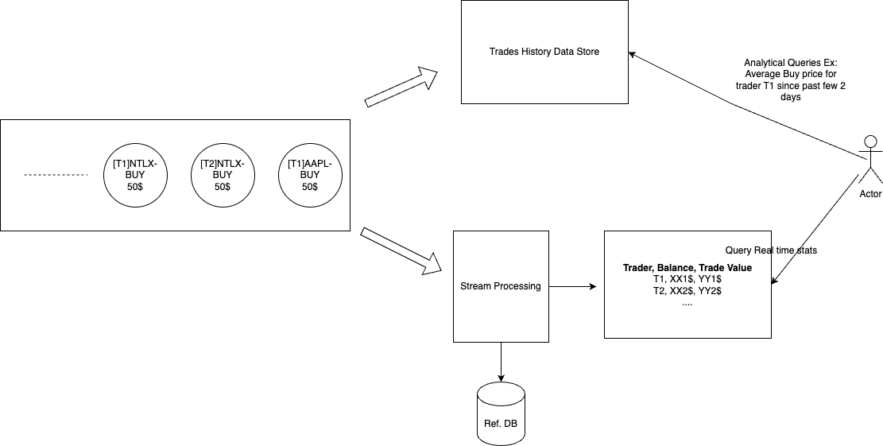
Trading System

Slide 6
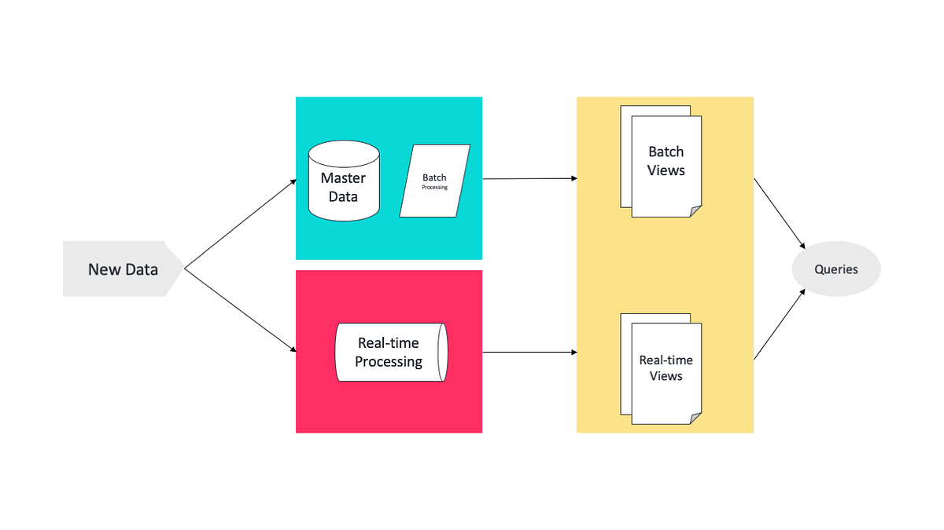
SnappyData
Lambda Architecture
Source: https://www.cidrdb.org/cidr2017/slides/p28-mozafari-cidr17-slides.pdf

Slide 7
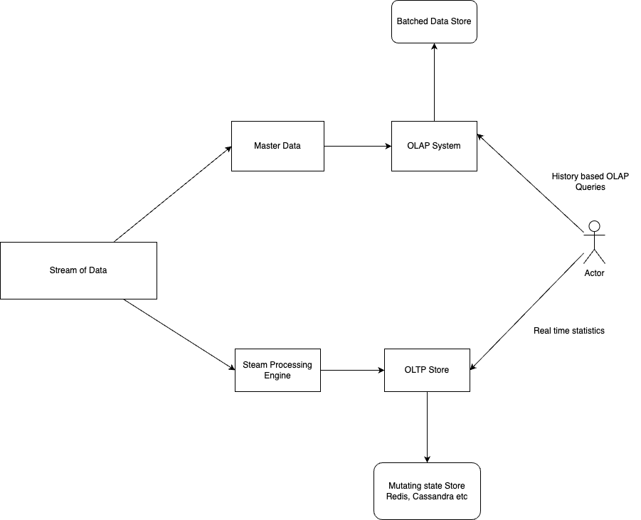
SnappyData
Lambda Architecture Contd.
Notes:
Mention the Problem of slowness of data transformation into OLAP Batch store
We are creating a solution involving multiple systems,

Slide 8
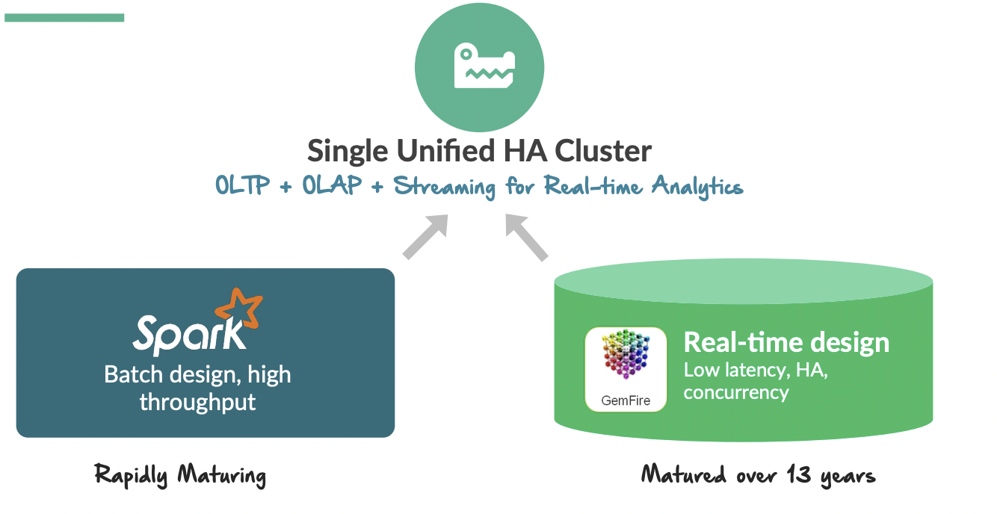
SnappyData Architecture
Source: https://www.cidrdb.org/cidr2017/slides/p28-mozafari-cidr17-slides.pdf

Slide 9
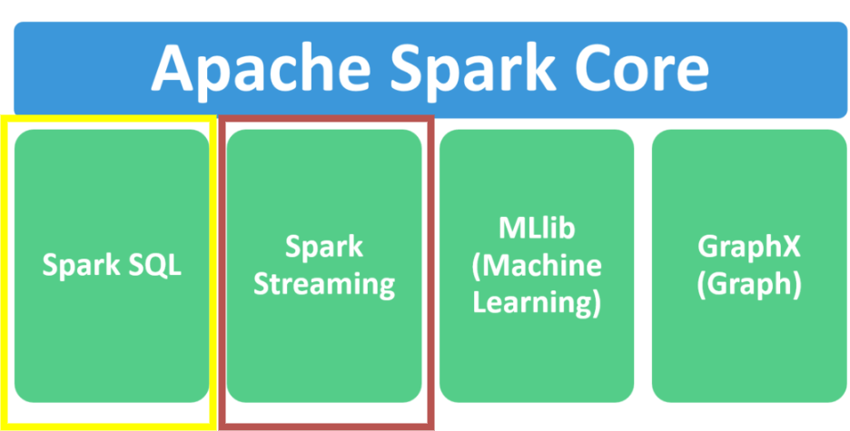
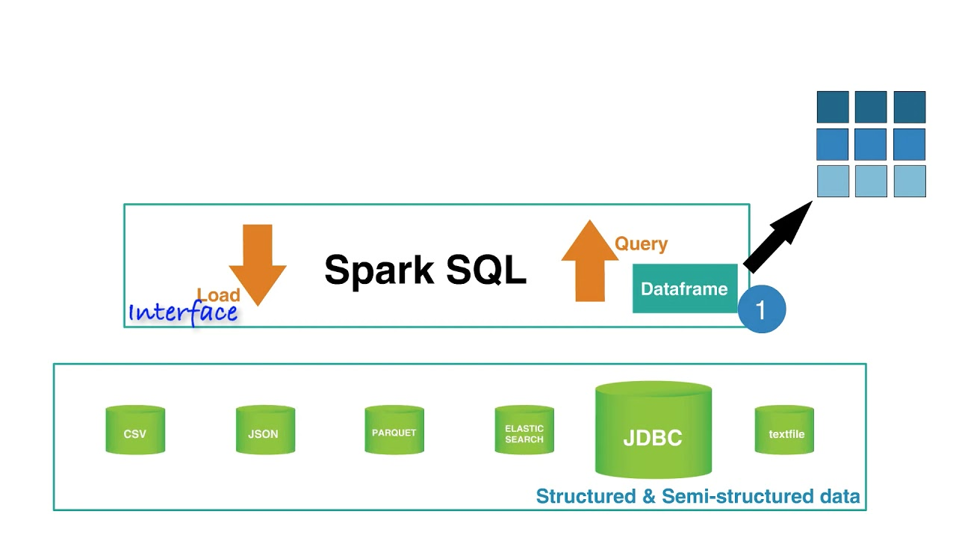
SnappyData
Spark
Source: https://www.youtube.com/watch?v=M40WQzjGePw&ab_channel=BigDataElearning

Slide 10
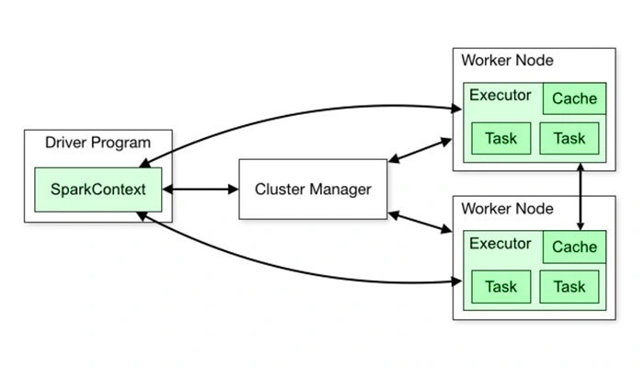
SnappyData
Spark Architecture
Source: https://www.analyticsvidhya.com/blog/2020/11/data-engineering-for-beginners-get-acquainted-with-the-spark-architecture/

Slide 11
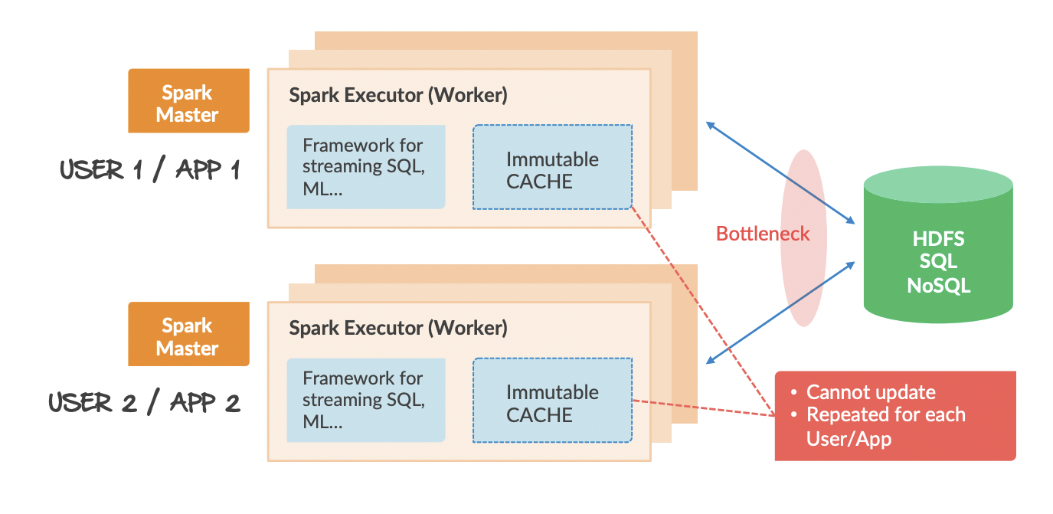
SnappyData
Traditional Spark
Source: https://www.cidrdb.org/cidr2017/slides/p28-mozafari-cidr17-slides.pdf

Slide 12
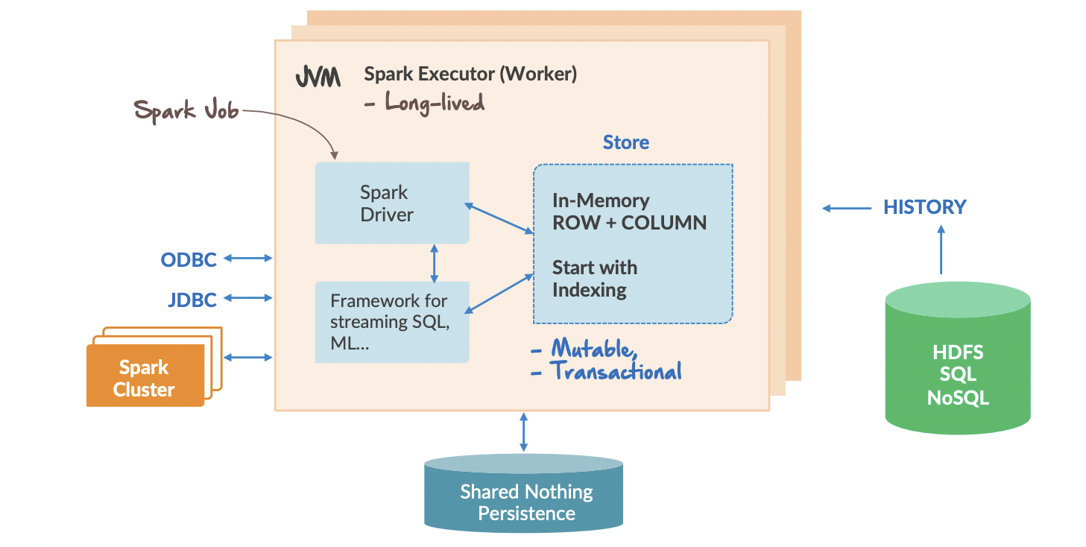
SnappyData
Spark Architecture
Source: https://www.cidrdb.org/cidr2017/slides/p28-mozafari-cidr17-slides.pdf

Slide 13
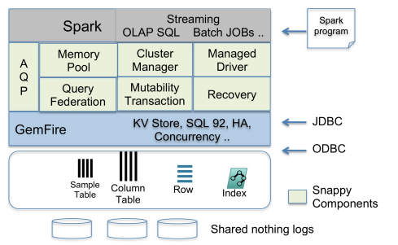
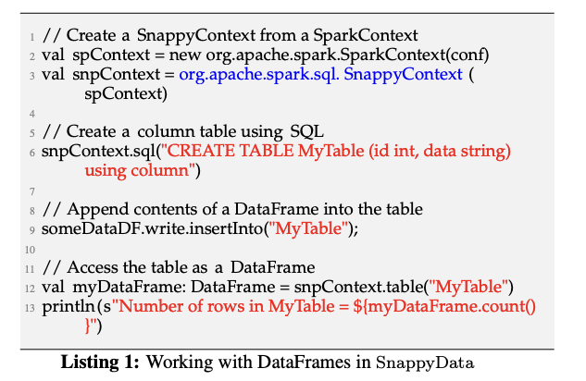
SnappyData
Source: https://www.cidrdb.org/cidr2017/slides/p28-mozafari-cidr17-slides.pdf

Slide 14
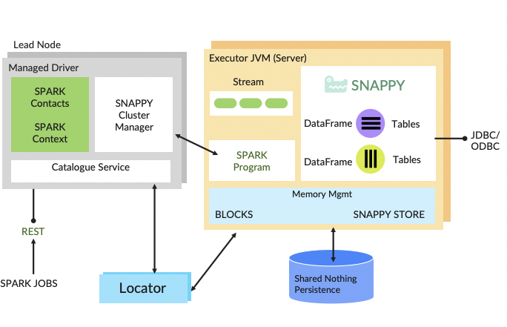
SnappyData
Catalogue Service
Source: https://www.cidrdb.org/cidr2017/slides/p28-mozafari-cidr17-slides.pdf

Slide 15
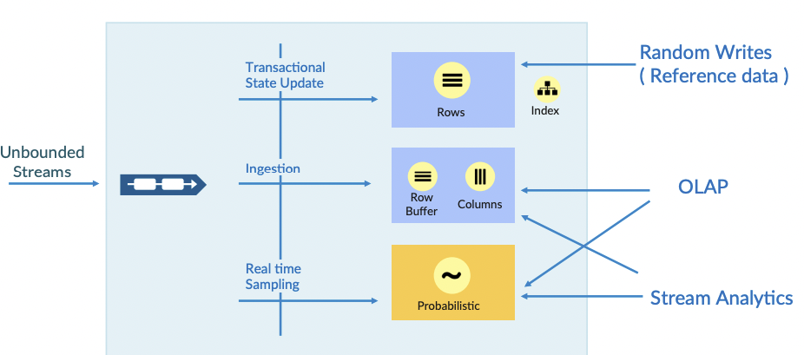
SnappyData
Data Models
Source: https://www.cidrdb.org/cidr2017/slides/p28-mozafari-cidr17-slides.pdf

Slide 16
SnappyData
Query Processing
SQL queries are federated between Spark’s Catalyst and GemFire’s OLTP engine
An initial query plan determines if the query is a low latency operation (e.g., a key-based lookup) or a high latency one (scans/aggregations).
SnappyData avoids scheduling overheads for OLTP operations by immediately routing them to appropriate data partitions
Transactions follow a 2-phase commit protocol using GemFire’s Paxos implementation to ensure consensus and view consistency across the cluster.
Source: https://www.cidrdb.org/cidr2017/papers/p28-mozafari-cidr17.pdf

Slide 17
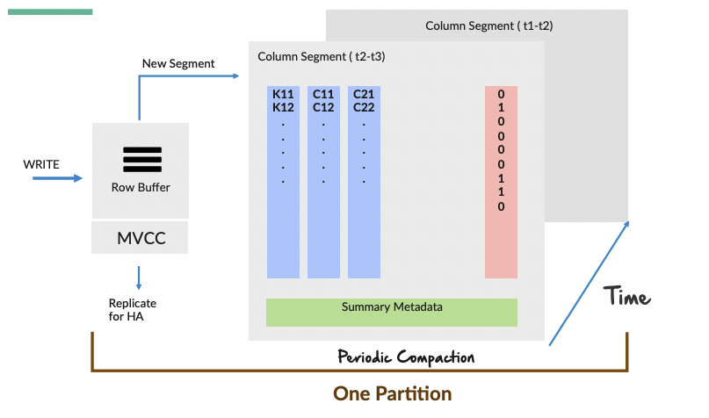
SnappyData
Column Store Updates
Source: https://www.cidrdb.org/cidr2017/slides/p28-mozafari-cidr17-slides.pdf

Slide 18
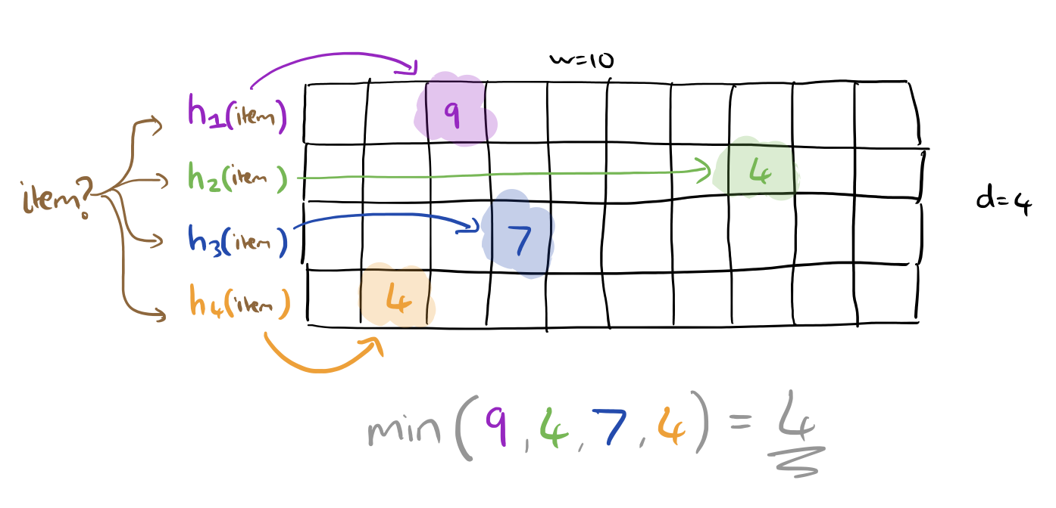
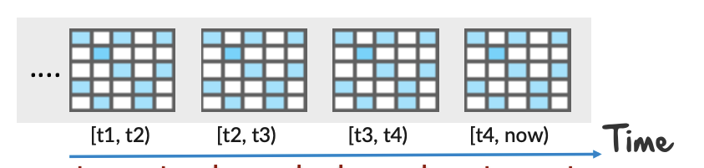
SnappyData
Probabilistic Data Store
SnappyData uses count min sketch data structure to empower AQP
The columns on which sampling can be enabled is either Join attributes(foreign keys) or they can determined at the run time by a tool WorkloadMiner
Snappy Data maintains samples separately for every t units of time
Source: https://www.cidrdb.org/cidr2017/slides/p28-mozafari-cidr17-slides.pdf

Slide 19
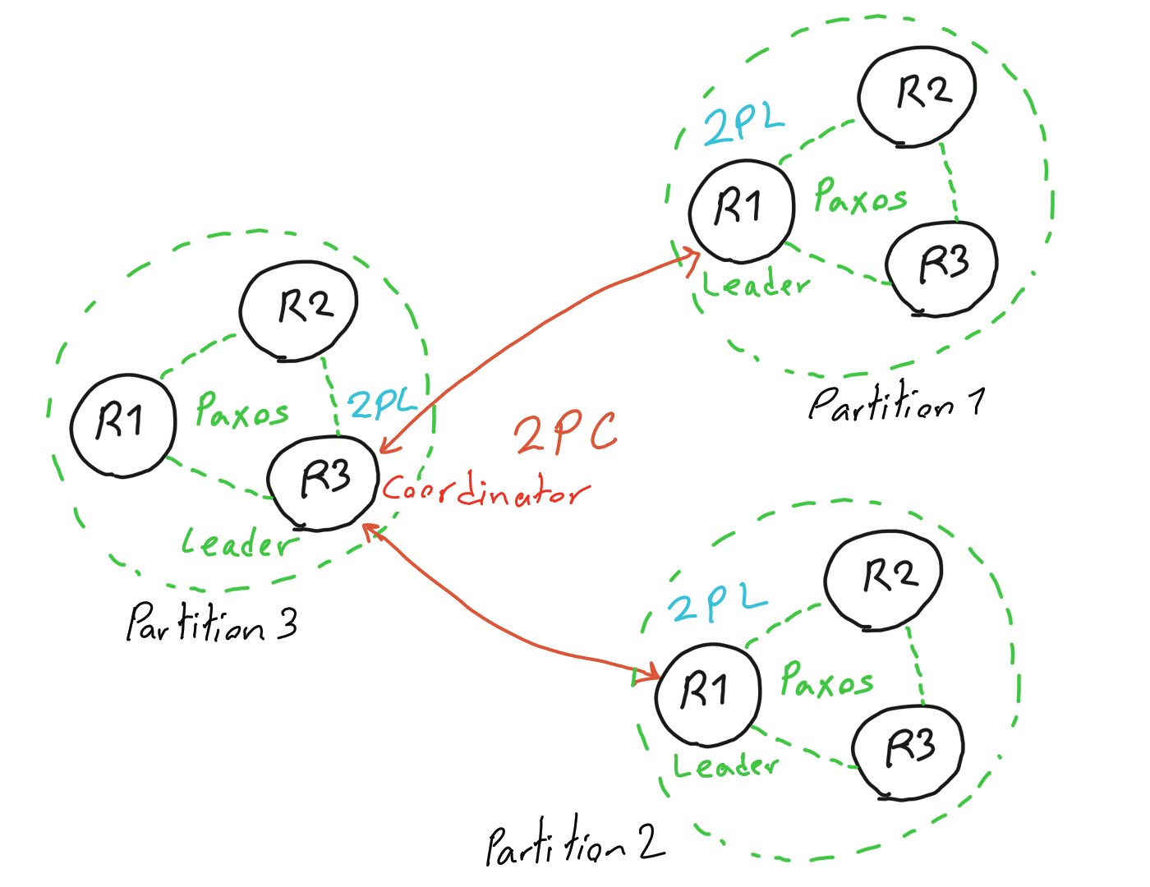
SnappyData
Scalability
Source: https://www.mydistributed.systems/2020/08/google-spanner.html

Slide 20
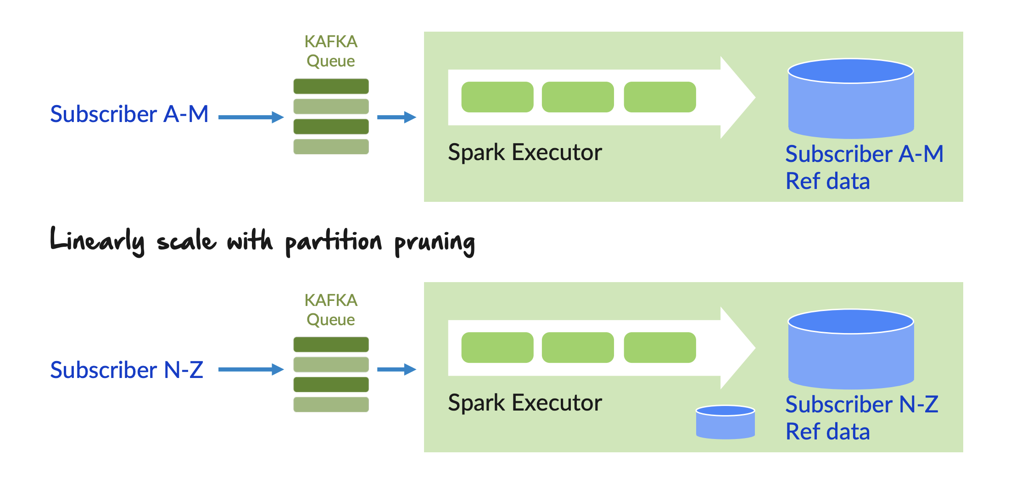
SnappyData
Co-Partition and Co-Location
Source: https://www.cidrdb.org/cidr2017/slides/p28-mozafari-cidr17-slides.pdf

Slide 21
SnappyData
Availability and Fault Tolerance
Driver Node has a secondary as a backup, whenever the primary fails secondary takes over.
This ensures the Client will always be able to send requests
For the Executor Nodes, the data is replicated through Paxos at Gemfire level.
This ensure n node failure tolerance semantics (Given that 2*n + 1 nodes for the Paxos group)

Slide 22

Disagg1
Presented by Rwitam Bandyopadhyay

Slide 23
Interesting DB that challenges traditional RDBMS
Iterative development over multiple papers
OLTP Through the Looking Glass, and What We Found There
The End of an Architectural Era (It’s Time for a Complete Rewrite)
The VoltDB Main Memory DBMS
All these papers are by Michael Stonebraker et. al. who is also one of the founders of VoltDB.

Slide 24
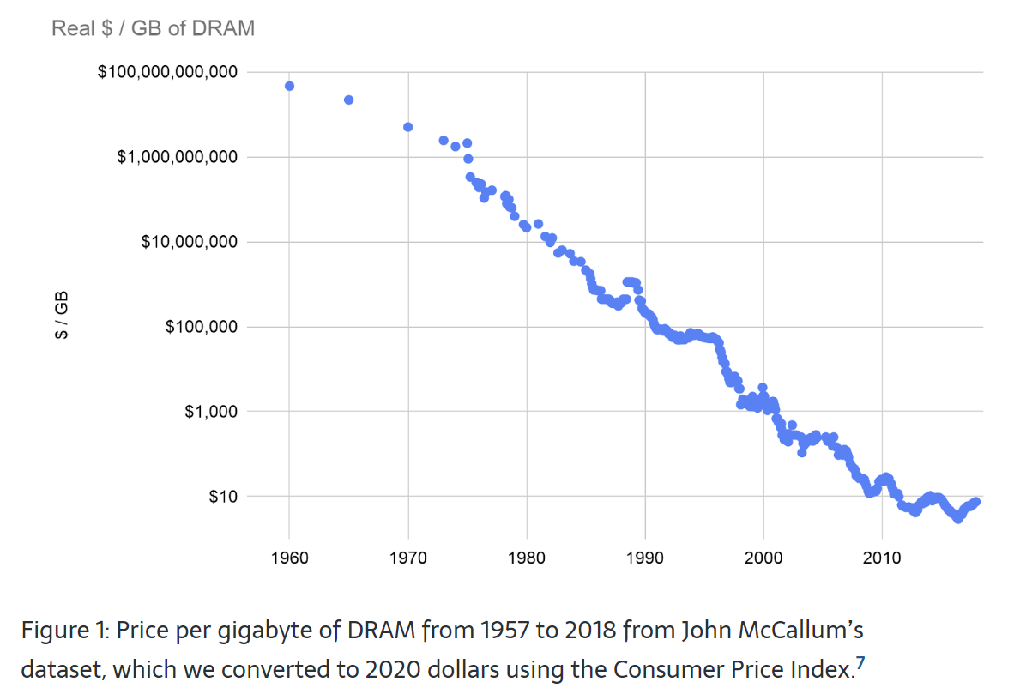
Shift towards main memory databases
Historically declining prices of DRAM
Source: AI Impacts - Trends in DRAM price per gigabyte

Slide 25
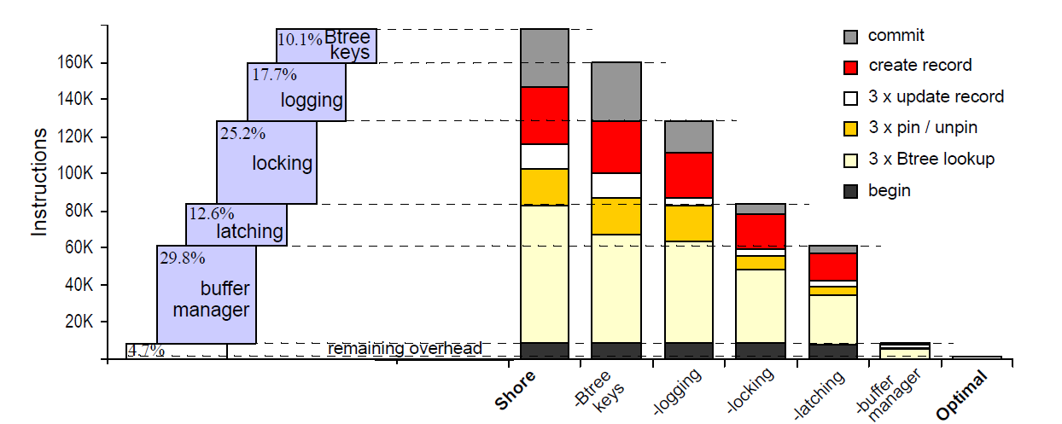
OLTP Overheads
Dissecting where time goes inside of a modern DBMS
Source: Harizopoulos et al. OLTP through the looking glass, and what we found there, SIGMOD '08: Proceedings of the 2008 International Conference on Management of Data.
Notes:
Looking at one of the papers “OLTP through the looking glass”, we can see that the authors have dissected where the time goes in a typical RDBMS. We can see that only about 4-7% of time (cpu cycles) go towards actual work done, and rest is consumed by the other components.

Slide 26
VoltDB Architecture
VoltDB Eliminates All of these Legacy DBMS Overheads
Data/ processing are partitioned together and distributed across the CPU cores (“virtual nodes”) in a shared-nothing hardware cluster.
Data is held in memory for maximum throughput and to eliminate the need for buffer management.
Each single-threaded partition operates autonomously, eliminating the need for locking and latching.
Data is automatically replicated for intra- and inter-cluster high availability

Slide 27
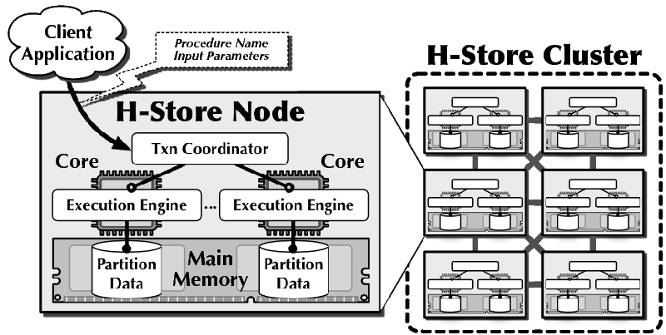
VoltDB Architecture
Borrowed majorly from H-Store (Shared Nothing)
Source: https://hstore.cs.brown.edu/documentation/architecture-overview/
Notes:
This is similar to MPP style architectures, that we also saw in GreenplumDB in the last presentation.

Slide 28
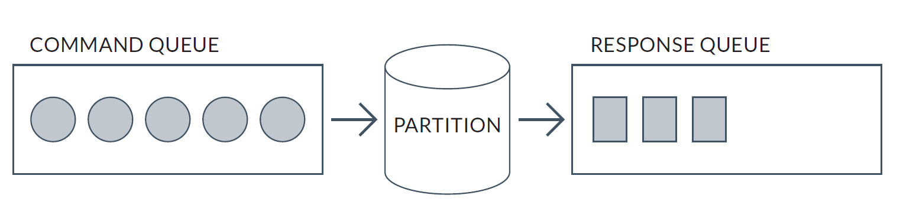
VoltDB Transactions
How can we achieve maximum throughput?
VoltDB ditches parallelism and goes towards sequential operations.
A command queue is filled up, and the CPU continuously loops through the commands and processes them, leading to 100% utilization.
Source: VoltDB Technical Note - How VoltDB does Transactions
Notes:
Considering ACID semantics, a partition can easily implement atomic, consistent and isolated semantics for each command. While executing the commands, the program maintains in-memory undo logs so that aborted commands can roll back. This provides atomicity. Constraints and data types are enforced during command execution to guarantee (ACID) consistency. Commands run one at a time without overlap, providing serializable isolation.
How do we make this model durable? If all of the commands have deterministic side-effects (running the same queue of commands in the same order against the same starting dataset is promised to produce the same ending dataset), then writing (and fsync-ing) the command queue to disk before executing the commands makes all data changes durable. To recover the ending state, we read the commands from disk and replay them. VoltDB calls this journal the “command log.”

Slide 29
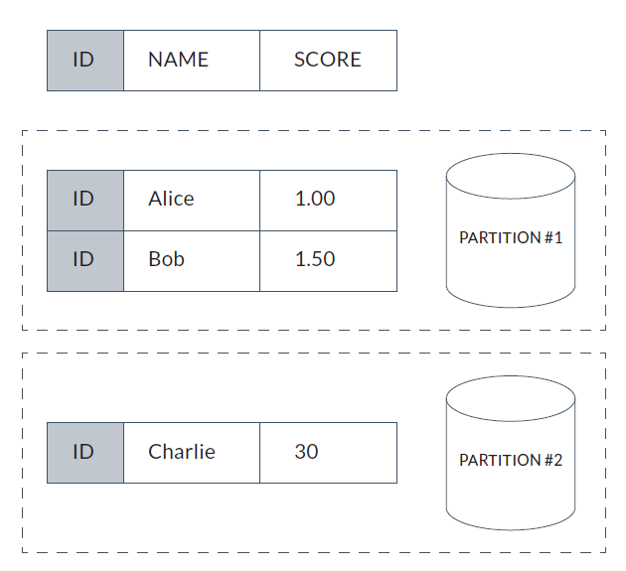
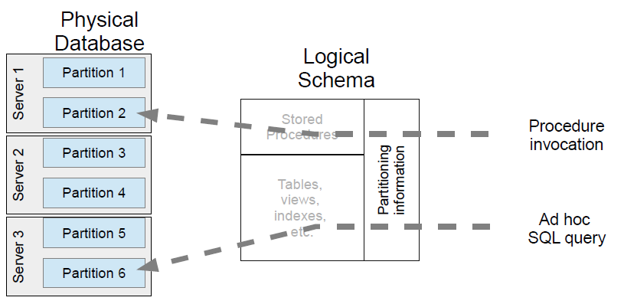
VoltDB Architecture
Scaling across multiple CPUs
Source: VoltDB Technical Note - How VoltDB does Transactions
Notes:
Saturating a single CPU with useful (fully ACID) end-user work is great. However, a server has several CPUs. How do we scale command execution across many CPUs? The first step is to partition (shard) the data and then queue commands to the relevant partition.
Here’s a simple table with three columns: Id, Name, and Score. In this example, the Id column is the user-specified partitioning column. The rows with Id=1 and Id=2 are assigned to partition #1. The row with Id=3 is assigned to partition #2.
Adding multiple partitions to a server (and then multiple servers to a cluster) allows the system to consume many CPU cores, each running per-partition commands. Each partition runs independently - each provides ACID semantics for the commands processed from its associated command queue.

Slide 30
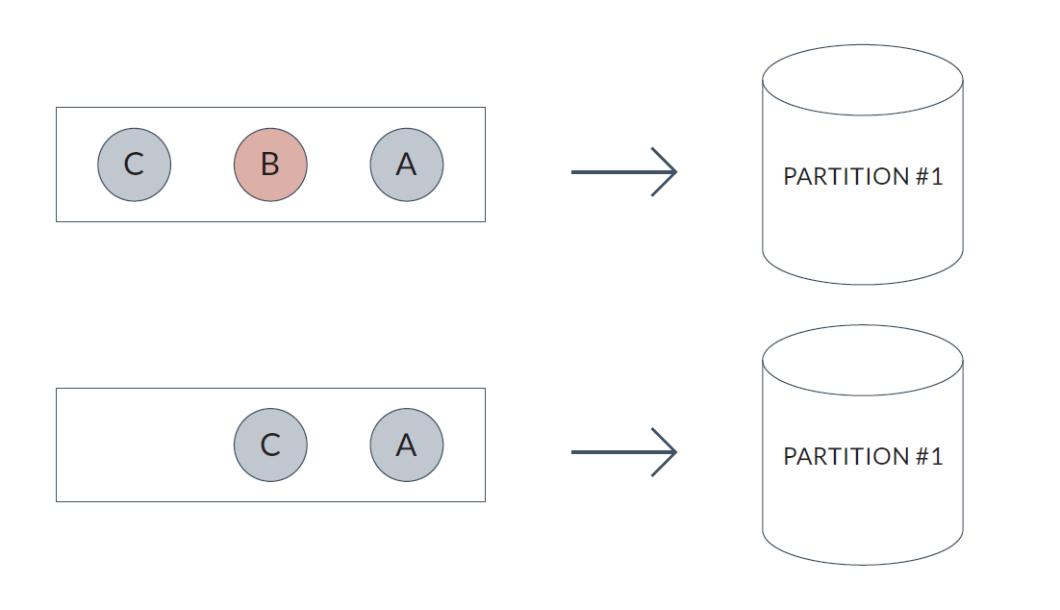
VoltDB Transaction Partitioning
Single Partition Transactions
Commands are replicated to all partition replicas, so they are consistent
Read commands can be directed to only one partition replica, since they do not change the data
Resulting serializable timeline is A -> C
Source: VoltDB Technical Note - How VoltDB does Transactions
Notes:
SPI – Single-partition initiator
Single-partition read-only transactions contain SELECT statements that read data from only one partition. They do not INSERT, UPDATE or DELETE data. As an optimization, read-only transactions skip the SPI sequencing process and are routed directly to a single copy of a partition. For both replicas, transaction C begins with the same partition #1 state.
MPI – Multi-partition initiator
VoltDB also supports transactions that read and write data at multiple partitions. The multi-partition initiator communicates with the per-partition SPIs to inject multi-partition commands into the per-partition
command queues.

Slide 31
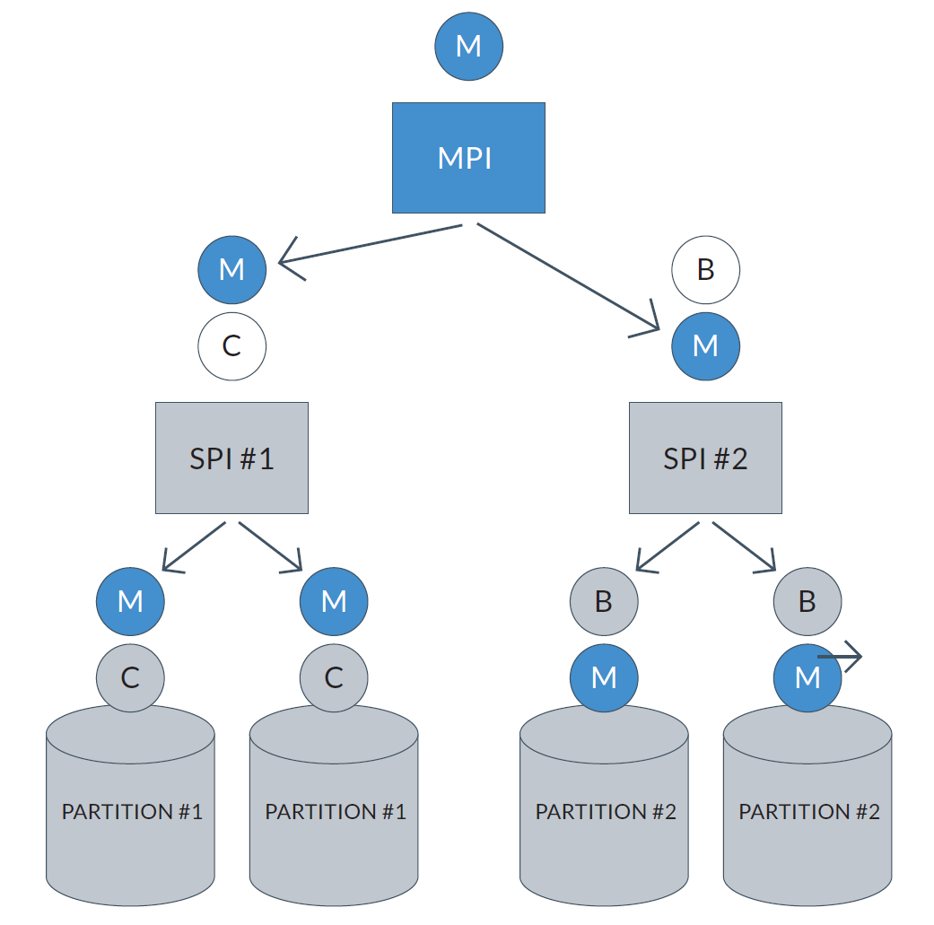
VoltDB Transaction Partitioning
Multiple Partition Transactions
M is a Multi Partition Transaction
B is a Single Partition Transaction
Multiple partition transactions have to be sent across multiple hosts/ virtual nodes.
Every node needs to “commit” successfully for the atomicity of the transaction to be maintained.
A 2-phase commit protocol is invoked between the partitions to ensure overall transactional consistency.
C is a Single Partition Transaction
Resulting serializable timeline is C -> M -> B
Source: VoltDB Technical Note - How VoltDB does Transactions
Notes:
SPI – Single-partition initiator
Single-partition read-only transactions contain SELECT statements that read data from only one partition. They do not INSERT, UPDATE or DELETE data. As an optimization, read-only transactions skip the SPI sequencing process and are routed directly to a single copy of a partition. For both replicas, transaction C begins with the same partition #1 state.
MPI – Multi-partition initiator
VoltDB also supports transactions that read and write data at multiple partitions. The multi-partition initiator communicates with the per-partition SPIs to inject multi-partition commands into the per-partition
command queues.

Slide 32
ACID Guarantees
What causes deadlocks/ delays/ waits?
Administrative Waits resulting from DBA commands that cause users to wait (for example, an index rebuild)
Application Waits resulting from user application code (for example, lock waits caused by row level locking or explicit lock commands)
Commit This wait class only comprises one wait event - wait for redo log write confirmation after a commit (that is, 'log file sync')
Concurrency Waits for internal database resources (for example, latches)
Configuration Waits caused by inadequate configuration of database or instance resources (for example, undersized log file sizes, shared pool size)
Network Waits related to network messaging (for example, 'SQL*Net more data to dblink')
System I/O Waits for background process I/O (for example, DBWR wait for 'db file parallel write')
User I/O Waits for user I/O (for example 'db file sequential read')
Source: https://docs.oracle.com/en/database/oracle/oracle-database/19/refrn/classes-of-wait-events.html

Slide 33
ACID Guarantees (Continued)
VoltDB circumvents most of the “waits”
We have no buffer/ log waits.
We have no need for locks because there are no concurrent transactions operating on a single row.
Traditionally, concurrent transactions were implemented to utilize the CPU more during IO waits.
Since VoltDB operates on main memory, there is almost no IO wait, hence we can give up on parallelism and do purely serial operations.
There are developer good practices to utilize VoltDB to it’s true potential. (<10ms transactions, stored procedures transactions only etc.)
Source: https://docs.oracle.com/en/database/oracle/oracle-database/19/refrn/classes-of-wait-events.html

Slide 34
ACID Guarantees (Continued)
Types of OLTP Operations
(Vast majority) Single-node transactions - In this case, there is a database design that allocates the shards of each table to nodes in such a way that most transactions are local to a single node. For eg. order placements, votes etc.
(Lesser number) One-shot transactions - For example, moving $X from account Y to account Z (without checking for an overdrawn condition) is a one-shot that will be executed at two nodes, one holding the shard of Y and the other the shard containing Z.
(Even less) General transactions - These are transactions that consist of multiple phases where each phase must be completed before the next phase begins.
Source: https://docs.oracle.com/en/database/oracle/oracle-database/19/refrn/classes-of-wait-events.html

Slide 35
VoltDB Transaction Summary
VoltDB executes commands to query and change data serially at a partition.
Commands can be ad hoc SQL, stored procedures, or SQL plan fragments.
Each command is run with strict ACID semantics.
Table data is distributed across partitions.
Execution is scaled across CPU cores (and servers) by adding partitions.
Performs really well if your business use-case is aligned to the adapted case of VoltDB.
Performs as good, if not better, when compared to traditional RDBMS if you have general purpose, multi-partition, cross-network transactions.
Source: VoltDB Technical Note - How VoltDB does Transactions

Slide 36
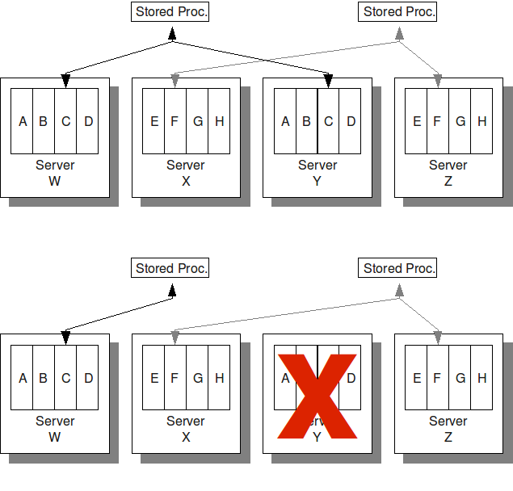
VoltDB Availability
Data durability?
K-Safety in Action
Snapshots
Command Logging (~WAL)
K-Safety
DB Replication
Source: Using VoltDB - https://docs.voltdb.com/UsingVoltDB/
Notes:
Since VoltDB is a main memory database, we need to worry about data durability.
Snapshots
We write a snapshot (aka checkpoint) of the in-memory state of the partition to disk. When this snapshot is completely written, the command log for commands preceding the snapshot can be forgotten. Starting a snapshot is another command that can be placed in the command queue and processed by the partition. Therefore, the snapshot has a distinct place on the serializable timeline and is a transactionally consistent copy of data.
Command Logging
VoltDB implements a concept called command logging for transaction-level durability. Unlike traditional write-ahead logs, VoltDB logs the instantiation of commands to the database rather than all
resulting actions. This style of logging greatly reduces the load on the disk system while providing either synchronous or asynchronous logging for transaction-level durability.
K-Safety
To keep copies identical, VoltDB replicates the commands that are queued at each partition. VoltDB does not replicate tuple changes as deltas across partitions - instead it synchronously replicates all commands
that can change data to all copies of a partition. Each partition individually runs the command against the data it manages. We maintain as an invariant that the commands in the command queue at each copy are
in the same order. The internal component that communicates the sequence of commands to all copies of a partition is called the single partition initiator (SPI).

Slide 37
Conclusion
VoltDB – HTAP?
VoltDB provides a scalable, fault-tolerant, serializable, fully durable, high throughput transaction-processing model.
As a side-effect of being a complete in-memory database, we get good OLAP performance too. The only real latency would be network latency resulting from multiple hosts.
Clusters/grids in datacenters theoretically have a very high overall main-memory capacity, so OLAP performance would be bottlenecked by total available memory.
To support aggregations in very selective columns, we can add an additional column store for user-defined columns.

Slide 38
DB2 BLU
Disagg1
Presented by Shubham Pandey

Slide 39
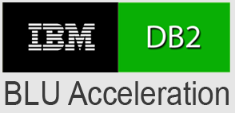
Introduction
Accelerate Business Intelligence queries in columnar storage (10-50x)
Improve compression (3-10x)
No reliance on indexes and materialized views
Perform predicate evaluation, join and grouping on compressed values
Process multiple records using SIMD instructions
Source: https://virtual-dba.com/platforms/ibm-db2-luw-old/db2-blu/
https://www.vldb.org/pvldb/vol6/p1080-barber.pdf

Slide 40

Data Layout and Compression
Frequency Compression
Compression scheme
Countries
Sampled Data
Statistics
1 bit
3 bits
8 bits
Source: https://www.vldb.org/pvldb/vol6/p1080-barber.pdf
Notes:
It exploits skew in data distribution and assigns the smallest codes to most frequent values. Lets consider a data of world economic countries.
To get a better understanding, assume that we have a sorted view of the data in terms of frequency, with the first block at the top representing top two most frequent countries. They can be represented using just 1 bit code. In reality, to determine the compression scheme, stats are collected by looking at sample of the data and creating histograms, and then the compression optimizer determines how to best partition column values, and then a dictionary is created for each partition.

Slide 41
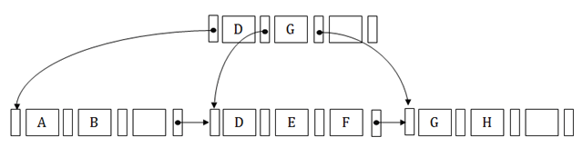
Data Layout and Compression
Column Group Storage
Page
C1
C2
C3
Page Header
TSN
<tuplet>
Start TSN
Tuplet Count
Page Map
Page ID -> Start TSN, CG
CG1
CG2
B+ Tree
Extent
Source: https://www.javatpoint.com/dbms-b-plus-tree
Notes:
Columns are partitioned into column groups and one column can only belong to one column group. And one column group can have multiple columns.
The column group data is stored in pages, and a larger unit of storage called extent contains fixed number of pages and is the unit of allocation for storage.
The projection of a tuple onto a column is called tuplet and they are stored in same order across all columns. They are identified by virtual identifier called tuple sequence number, in short TSN. Page header contains information about start TSN and the tuple count. And we have a Page Map that records the start TSN of each page and the column group it belongs to, and this is stored in form of B+ tree to find pages that contain a range of TSNs for a column group.

Slide 42
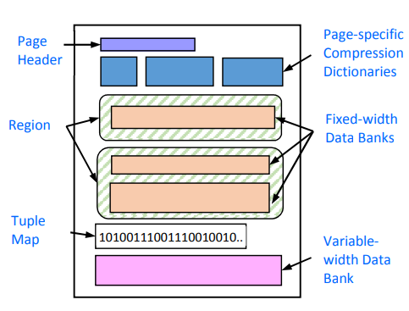
Data Layout and Compression
Page Format
Source: https://www.vldb.org/pvldb/vol6/p1080-barber.pdf
Notes:
So this is the overall view of a page, I would only highlight some important details here. Since the tuple sequence is determined by the order in which data is inserted, which is independent of how tuple is encoded for compression, within each page, tuplets that belong to same compression technique would be grouped together into regions. Tuple maps store which region each tuple belongs to, in this case since there were only two regions, we used 1 bit for each tuple to show where it is. Variable width data bank takes care of variable width values like varchar, and a descriptor column containing (offset, length) is stored in a regular region to locate the desired value.

Slide 43
Scans and Predicate Evaluation
Leaf Predicate Evaluator (LEAF)
Load Column Evaluator (LCOL)
Source: https://www.vldb.org/pvldb/vol6/p1080-barber.pdf
Notes:
Now, I want to talk a bit about how columns are accessed. There are two access methods, namely leaf predicate evaluator and load column evaluator. And these two operators form the foundation of all the other complex operations like joins, aggregates, etc.

Slide 44
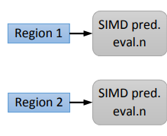
Scans and Predicate Evaluation
Leaf Predicate Evaluator (LEAF)
Source: https://www.vldb.org/pvldb/vol6/p1080-barber.pdf
Notes:
LEAF applies predicates on one or more columns within a column group. The input to this is the list of TSNs. Notice that evaluation of predicates is done with SIMD instructions. The objective is to apply this operator as much as possible because it is more efficient to do so on compressed data. If we go back to the countries example, then lest say that region 1 in a page is 1 bit codes, and region2 is 3 bit coded. We separately apply the predicate on them as shown here.

Slide 45
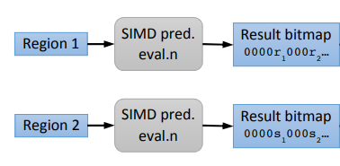
Scans and Predicate Evaluation
Leaf Predicate Evaluator (LEAF)
Source: https://www.vldb.org/pvldb/vol6/p1080-barber.pdf
Notes:
After that, we get result in form of bitmap saying which tuples in the region satisfied the predicate. You can observe that for each region, we have a result where in form of the least significant bit of each tuplet, denoting whehter it qualified predicate or not.

Slide 46
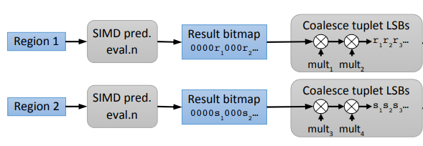
Scans and Predicate Evaluation
Leaf Predicate Evaluator (LEAF)
Source: https://www.vldb.org/pvldb/vol6/p1080-barber.pdf
Notes:
After this, they coalesce these LSBs and append them to a bit vector of outputs. This is achieved through bit manipulation logic in form of multiplication. And as you can see, in the end we have a bit vector with 0s and 1s indicating whether tuplet satisfies the predicate or not.

Slide 47
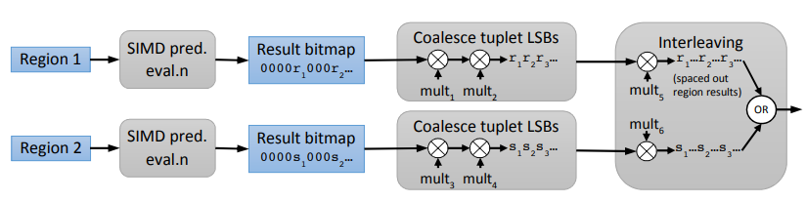
Scans and Predicate Evaluation
Leaf Predicate Evaluator (LEAF)
Source: https://www.vldb.org/pvldb/vol6/p1080-barber.pdf
Notes:
Finally, using the information about distribution of tuplets among regions, these bits can be interleaved to get the final bit vector for the whole page again using bit manipulation logic.

Slide 48
Scans and Predicate Evaluation
Load Column Evaluator (LCOL)
Data Access Operator
Output is Compacted
Works on 1 region at a time
Source: https://www.vldb.org/pvldb/vol6/p1080-barber.pdf
Notes:
LCOL is the main data access operator. The output of LCOL is always compacted, meaning that it only produces outputs for the entries with valid TSNs, i.e., those that satisfy all the predicates applied previously. LCOL also works 1 region at a time.

Slide 49
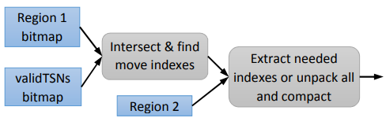
Scans and Predicate Evaluation
Load Column Evaluator (LCOL)
0 1 0 1 0 1
t2, t3
1 0 0 1 1 1
t1, t3
Source: https://www.vldb.org/pvldb/vol6/p1080-barber.pdf
Notes:
Lets see how this works from left to right. First it takes two inputs, the region bitmap, which tells us out of all the tuplets in the page, which ones are in this region. And valid TSNs bitmap tells us which tuplets in the page have passed all the predicates executed before this stage.
With this information, LCOL can go ahead and take the intersection of these two bitmaps and find out what tuplets from region 1 should move forward.
For example, <illustrate the animation....>
When loading small subset from the region, we directly do masks and bit manipulation to extract corresponding codes, but if most the tuplets in region qualify, we unpack the entire region and then extract the needed ones.

Slide 50
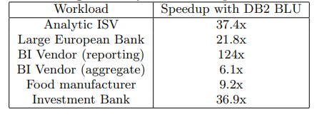
Performance Improvements
Source: https://www.vldb.org/pvldb/vol6/p1080-barber.pdf

Slide 51
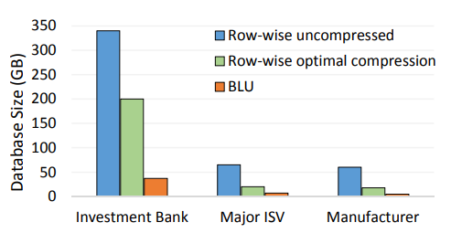
Storage Costs
Source: https://www.vldb.org/pvldb/vol6/p1080-barber.pdf

Slide 52
Project Summary
Milestone 1
Oracle Dual Format
Milestone 2
PolarDB
SingleStore
Greenplum DB
SAP HANA
TiDB
Final Presentation
Snappy Data
VoltDB
DB2 BLU
Summarize the studied systems
Milestone 3

Slide 53
Thank YOu

